Slide 1

Mu Sigma - Food Wastage Optimization in Cafeteria
Do The Math
Chicago, IL
Bangalore, India
www.mu-sigma.com
Chicago, IL
Bangalore, India
www.mu-sigma.com
July, 2018
Proprietary Information
Proprietary Information
"This document and its attachments are confidential. Any unauthorized copying, disclosure or distribution of the material is strictly forbidden"
"This document and its attachments are confidential. Any unauthorized copying, disclosure or distribution of the material is strictly forbidden"

Slide 2
Agenda
Problem Statement
SGQ: Problem Definition Framework
Trend Analysis
Research: Factors involved
Analysis of key factors
Takeaways
Recommendations
Future of Project

Slide 3



Inspection of the problem reveals three key focus areas – reducing wastage, increasing employee satisfaction & reducing losses incurred
Problem Statement
Primary Problem Statement –
To prioritize and optimize food waste prevention and management for snacks from a current scenario of 11.5% to 5% of the amount ordered (in plates).
Secondary Problem Statement –
To rework the menu so as to increase employee satisfaction and reduce monetary outflow.
11.5%
5%

Slide 4
Agenda
Problem Statement
SGQ: Problem Definition Framework
Trend Analysis
Research: Factors involved
Analysis of key factors
Takeaways
Recommendations
Future of Project

Slide 5
Mu Sigma wants to reduce the food wastage from a current 11.5% (since last November) to 5% of the plates ordered
Need to identify and prioritize the potential factors which impact food wastage
The Admin Team of Mu Sigma is responsible for providing food to all its employees and staff. 11.5% of the snacks ordered since November, 2017 has been wasted.
Over time, wastage of food has generated a significant loss for Mu Sigma
A heuristic method of estimating the quantity of food is being used which is not accurate enough
Outcome: The Admin Team has reduced the daily wastage of snacks to 5% of the amount ordered
Behavior: Food is being ordered based on results from the survey, which is conducted quarterly and based on the tool we have created to predict food wastage
Insight: Assess the impact of the following on food wastage
The number of employees present in the company to eat in the cafeteria
The behavior of the employees
Vendor specific variables
External environment factors
What are the factors and how do they impact food wastage?

Slide 6
Agenda
Problem Statement
SGQ: Problem Definition Framework
Trend Analysis
Research: Factors involved
Analysis of Key Factors
Takeaways
Recommendations
Future of Project

Slide 7
Date-level trend
The focus is on April-June ’18 (even though the graph shows a downward trend), since November to early 2018 was an experimental phase

Slide 8


Month-wise trend
Although wastage has decreased from April to May, it has substantially increased from May to June
FINDINGS
May has seen the highest number of plates ordered and the least number of plates wasted
Wastage in June is more than double that of May (data till 22nd June)
SUGGESTIONS
Use May’s strategy of ordering and implement the same for June

Slide 9
Item-wise trend
Onion pakoda is the most wasted item on the menu followed by idly
FINDINGS
Onion pakoda accounts for thrice the average percentage of wastage which is 6.26 and idly is almost double the average wastage.
On the other hand, items like Baby corn chilli, bisi bele bath, jamoon, samosa, Pongal and vada are doing well.
6.6
SUGGESTIONS
Items that are doing well can be ordered more of.
Further inspection can be done on the items which are being wasted more.

Slide 10
Agenda
Problem Statement
SGQ: Problem Definition Framework
Trend Analysis
Research: Factors involved
Analysis of key factors
Takeaways
Recommendations
Future of Project

Slide 11









We will analyze the seven key factors that could impact food wastage one by one over the months of April, May, June
3
5
7
Employee’s experience in the company
Age of the employee
Personal Preference
Day of the week
1
Difference in plates brought by vendor
Designation
Origin of the Employee
Leaves Taken by Employees
2
4
6
8

Slide 12
Agenda
Problem Statement
SGQ: Problem Definition Framework
Trend Analysis
Research: Factors involved
Analysis of key factors
Takeaways
Recommendations
Future of Project

Slide 13
Factor 1: Day of the Week
Monday and Wednesday account for the highest wastage of food in a given week
FINDINGS
Monday and Wednesday see high wastage percentages, which is almost triple that of Tuesday and Thursday.
Wasted/ordered * 100
Friday, which used to experience the highest wastage is now better optimized.
SUGGESTIONS
Focus on reducing wastage on Monday and Wednesday by analyzing the menu.

Slide 14
Factor 2: Difference in plates brought by the vendor
Lesser plates are delivered on Mondays and still it sees the highest wastage
FINDINGS
On average, 101 extra plates are delivered on Tuesdays, but still least amount of food is wasted on Tuesdays.
On Mondays, fewer number of plates are delivered, yet it sees the highest wastage.
SUGGESTIONS
Reduce amount delivered on Monday.

Slide 15
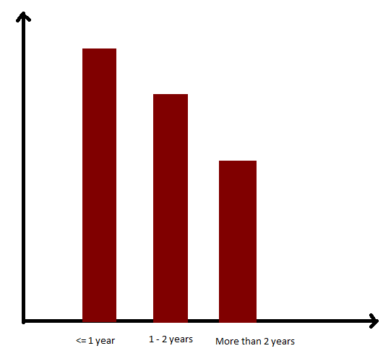
Factor 3: Employee Experience
Employees with more years of experience in the company tend to visit the cafeteria less frequently
FINDINGS
Illustrative
Experience of the employee in years vs the average number of times they have swiped into the cafeteria
Employees with less than one year experience visited the cafeteria frequently.
People who have been in the company for longer might have grown used to the food served in the cafeteria.
Average Swipe count
SUGGESTIONS
Introducing new items into the menu might appeal to all employees.
Experience in years

Slide 16
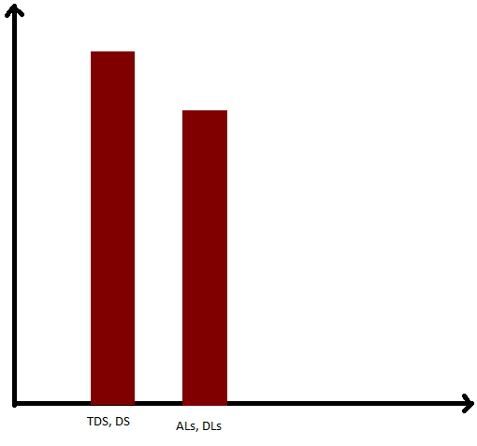
Factor 4: Designation of the Employee
Designations such as TDS and DS visit the cafeteria more frequently than the others
FINDINGS
Illustrative
Designation of the Employee vs the average number of times they have swiped into the cafeteria
Trainee Decision Scientists and Decision Scientists have a higher number of swipe in records relatively.
This can be due to the fact that the other employees are either traveling or are busy in meetings, having no time for snacks.
Average Swipe count
Employees with a relatively lower salary visit the cafeteria more often (since designation is analogous to salary).
Designation of the Employee

Slide 17
Factor 5: Age of the Employee
Employees who are above the age of 35 visit the cafeteria more regularly
FINDINGS
The employees older than 35 years of age show a trend of visiting the cafeteria more regularly.
The snacks being served on certain days may appeal more to the older crowd, hence they probably visit the cafeteria more often.
Average Swipe count
<27
27-35
>35
Age of the Employee

Slide 18
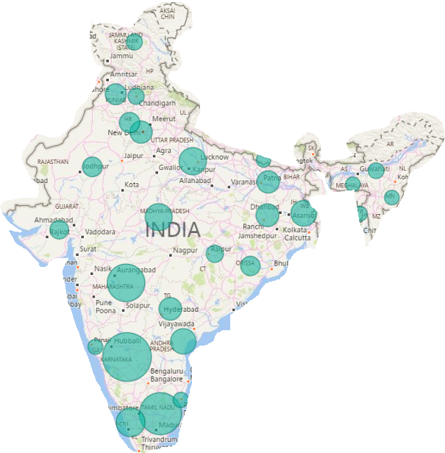
Factor 6: Origin of the Employee
Demographics reveal that there are more North Indian employees than South Indian employees in the company
FINDINGS
From a sample of 1959 employees, demographics reveal that there are 1181 South Indians, 1829 North Indians and people from outside of India.
(Inconsistency of data, will update)
1083 North Indians
SUGGESTIONS
North-Indian items can be ordered more frequently.
872 South Indians

Slide 19
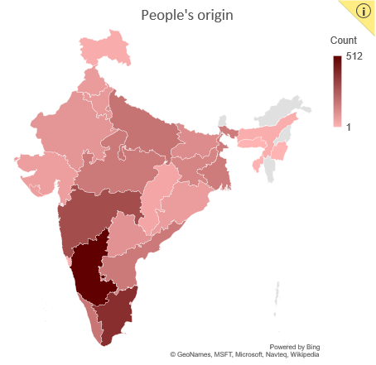
A large percentage of people hail from Karnataka, followed by Tamil Nadu
Factor 6: Origin of the Employee

Slide 20

Order more of Gulab Jamoon and ice cream and order less of mango custard and jangri
Items in the top left quadrant should be ordered more frequently as it is low wastage and high score
(score = number of likes – number of dislikes)
Items in the bottom right quadrant should be ordered less of as they have high wastage and less score

Slide 21
Order more of Masala dosa , Vada and Poha and less of vegetable idly and shavige bath
Items in the top left quadrant should be ordered more frequently as it is low wastage and high score
(score = number of likes – number of dislikes)
Items in the bottom right quadrant should be ordered less of as they have high wastage and less score

Slide 22
Order more of Samosa and less of Veg Puff
Items in the top left quadrant should be ordered more frequently as it is low wastage and high score
(score = number of likes – number of dislikes)
Items in the bottom right quadrant should be ordered less of as they have high wastage and less score

Slide 23
Factor 8: Leaves taken by employees
Leaves taken by employees is not a viable factor since correlation between the no. of employees absent and amount of food wasted is low
FINDINGS
The correlation coefficient between leaves taken by employees and food wastage is 0.394, our threshold being 0.5
Number of absent employees
We can see that the slope of the best fit line across these points ~0, if not for certain points (indicated with arrows), high up in the graph.
Ratio of Wasted in plates/Ordered in plates

Slide 24
Agenda
Problem Statement
SGQ: Problem Definition Framework
Trend Analysis
Research: Factors involved
Analysis of key factors
Takeaways
Recommendations
Future of Project

Slide 25

Key Takeaways
11.5% of the ordered food is wasted. Nov ‘17 to early 2018 being an experimental phase are not being focused on.
1
May has done well in terms of percentage of food wasted, whereas June hasn’t. Mondays see the highest wastage among all the days.
2
3
Percentage wastage of tiffins, desserts and chaats are 8.39%, 5.56% and 1.32%. Desserts and chaats seem to be doing much better than tiffins.
4
Absentee count does not affect wastage of food as the Food Committee already takes this account and orders lesser food.

Slide 26
Agenda
Problem Statement
SGQ: Problem Definition Framework
Trend Analysis
Research: Factors involved
Analysis of key factors
Takeaways
Recommendations
Future of the Project

Slide 27
Recommendations
Order significantly less number of plates on Mondays and restructure the menu such that Mondays see lesser wastage
The cafeteria experience can be made better by introducing ideas like Special Regional Days; getting Tamilian food on Tamil New Years and fixing certain items on particular days.
1
2
If a particular approach was adopted to bring very low wastage in May, continue to use that strategy to bring low wastage numbers in the following months.
Items highly preferred can be ordered on Mondays (which sees the highest wastage) to reduce percentage wastage.
3
4

Slide 28
Agenda
Problem Statement
SGQ: Problem Definition Framework
Trend Analysis
Research: Factors involved
Analysis of key factors
Takeaways
Recommendations
Future of Project

Slide 29
Future of the Project
Will people like the food I am going to order?
Integrate survey with food tool such that it is sent out every month and the corresponding scatter plot is generated. It gives them a picture about people's personal preferences.
Integrate dashboard with the food tool that gives you the required visualizations to analyze the data and have a look at the various factors.
Why don’t we use a dashboard?
Can I order New Item “XYZ”?
From the analysis obtained, the effect of the various experiments performed by the admin team have been quantified. Hence, the admin team has a reference incase they want to try out a new menu.

Slide 30
